Slide 1
SpineX
Updated by Mashhur, 2015.07.12

Slide 2
Content
Objectives of SpineX
H/W & S/W description notes
Spine Care App
- Workouts plan

Slide 3
Objectives of SpineX
Tiny healthcare device to monitor spine with smart technologies.
This helps to improve posture, monitor spinal behaviour, and guide for healthy life style.

Slide 4
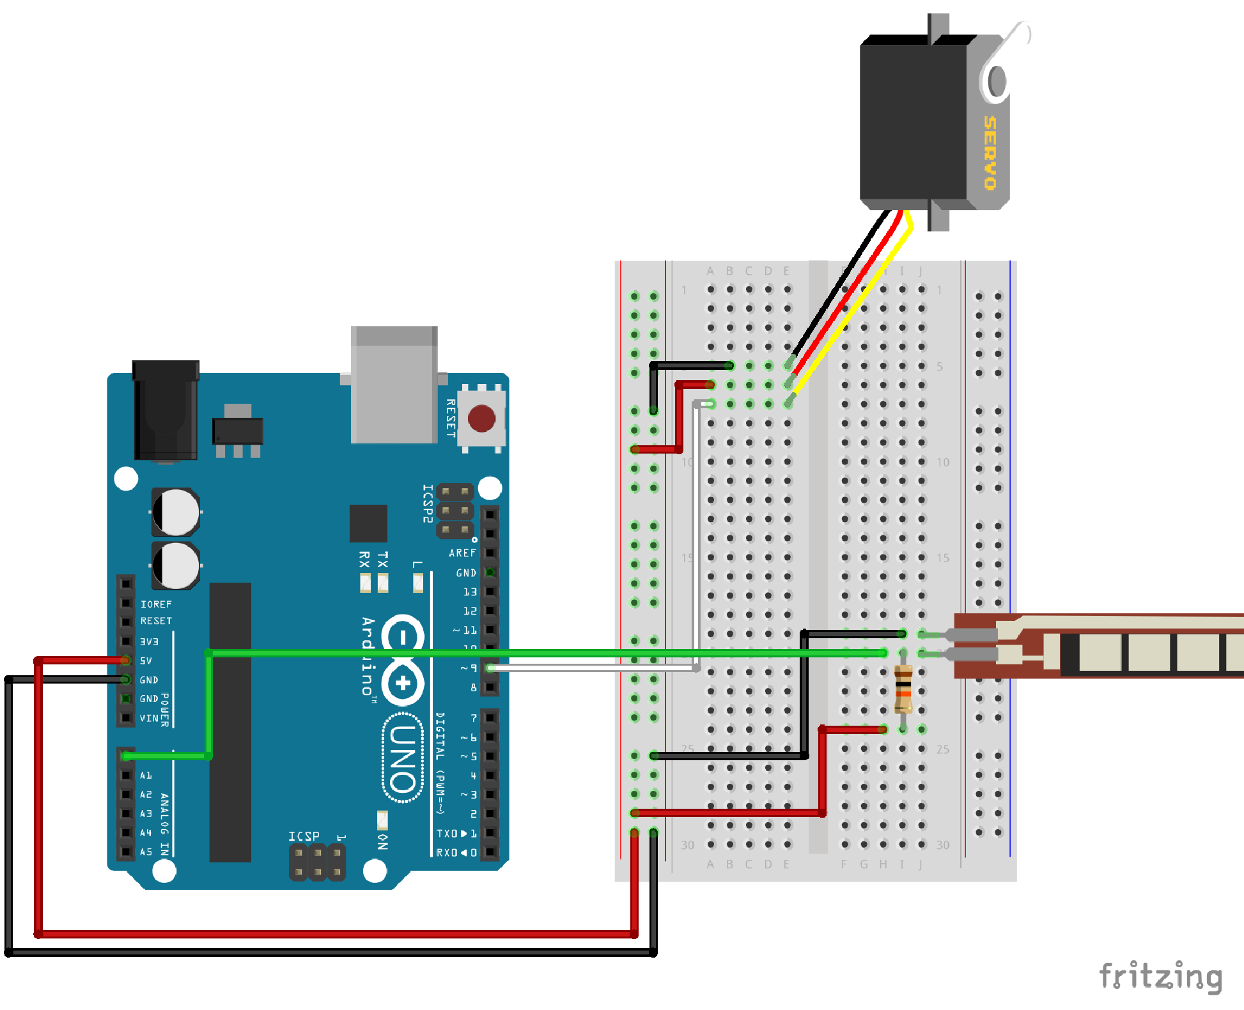
Technical notes: Interfacing with Flex 4.5”
Monitoring analog pin with serial
communication loop.
Used ping: A0
H/W: 22kOmh resistance
Serial baud rate: 9600bps

Slide 5
Flex 4.5” S/W Module
int flexSensorPin = A0; //analog pin 0
void setup()
{
Serial.begin(9600);
}
void loop()
{
int flexSensorReading = analogRead(flexSensorPin);
Serial.println(flexSensorReading);
//reading on the arduino between 512, and 614.
//Using map(), you can convert that to a larger range like 0-100.
int flex0to100 = map(flexSensorReading, 512, 614, 0, 100);
Serial.println(flex0to100); delay(250); //just here to slow down the output for easier reading
}

Slide 6
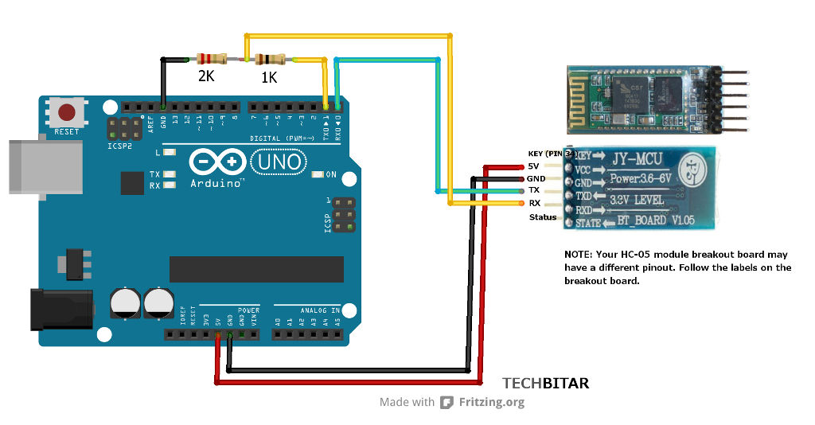
Interfacing with a Bluetooth module

Slide 7
Bluetooth S/W module
/*** Bluetooth Module Interface ****/
#include <SoftwareSerial.h>
SoftwareSerial mySerial(2, 3); // RX, TX
// the setup function runs once when
// you press reset or power the board
void setup()
{
Serial.begin(9600);
while(!Serial)
{
;// wait for serial port to connect. Needed for Leonardo only
}
// set the data rate for the SoftwareSerial port
mySerial.begin(9600);
mySerial.println("Hello, world?");
}
// the loop function runs over and over again until power down or reset
void loop()
{
int nByte = 0;
if(Serial.available())
{
nByte = Serial.read();
Serial.print("Byte: "); Serial.println(nByte); Serial.print("");
int nBluetooth = mySerial.available();
Serial.print("Bluetooth: "); Serial.println(nBluetooth); Serial.print("");
if(nBluetooth > 0)
{
mySerial.write(nByte);
if(nByte > 0)
{
Serial.write(nByte); Serial.print("Data Send to Bluetooth: ");
Serial.println(nByte); Serial.print("");
}
}
delay(100);
}
}

Slide 8
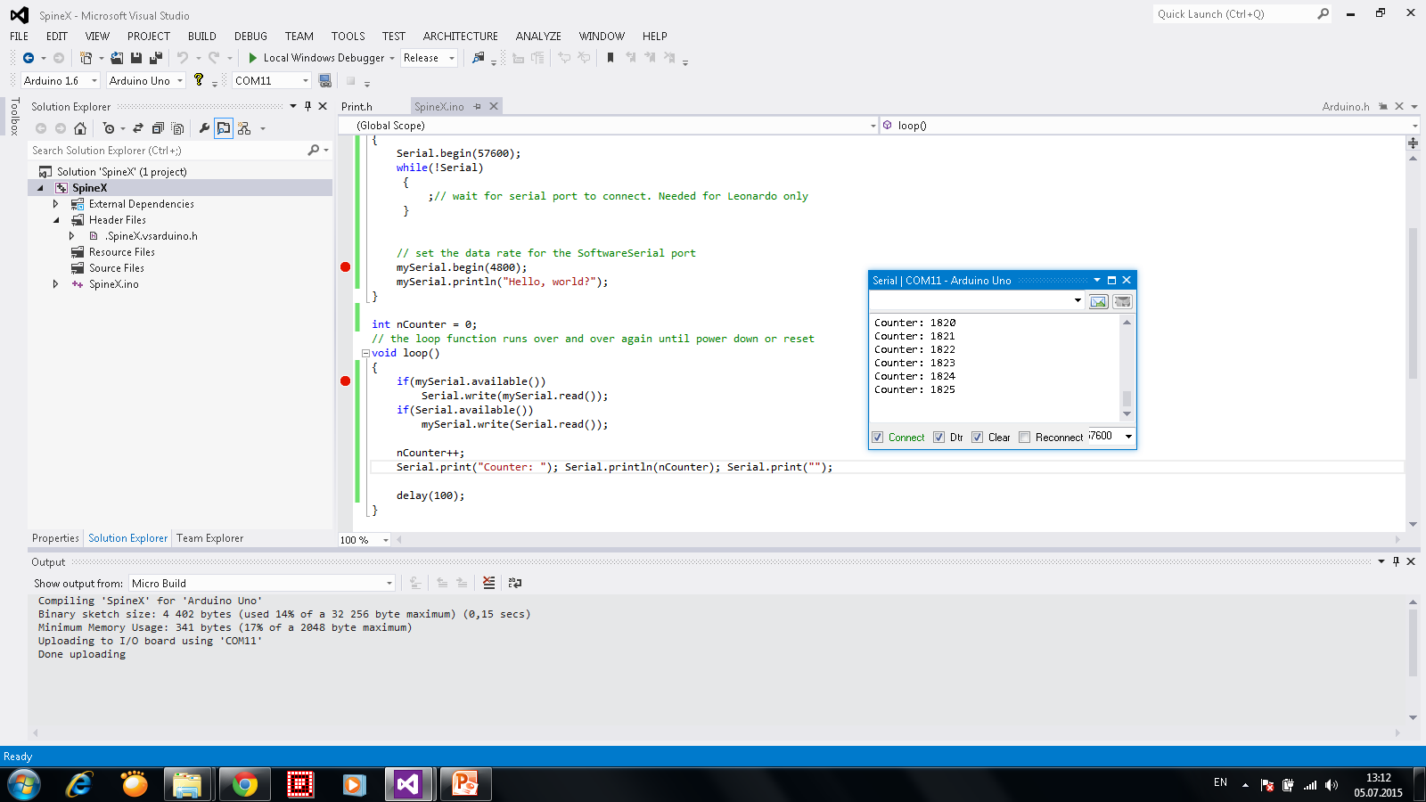
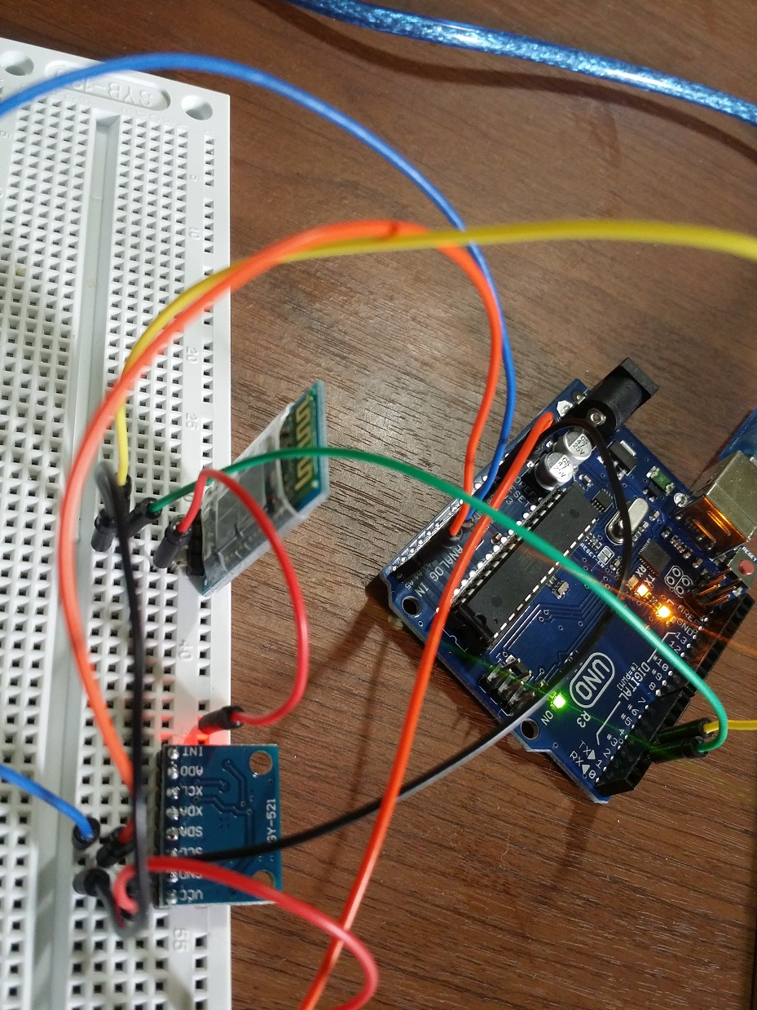
Implementation
Environment:
- Arduino EDI 1.6
- Arduino debugger visual micro (http://www.visualmicro.com/)
Transfer/Receiver Indicator
Serial Test Program

Slide 9
Bluetooth module implementation
H/W :
- Used pins: DIO 3 – Tx , DIO 2 – Rx
Operation: On an Android phone (used Note 3 with Lollipop):
- BlueSerail Beta
- Search for Bluetooth device, HC-06 appears, pair it with 1234 code.

Slide 10
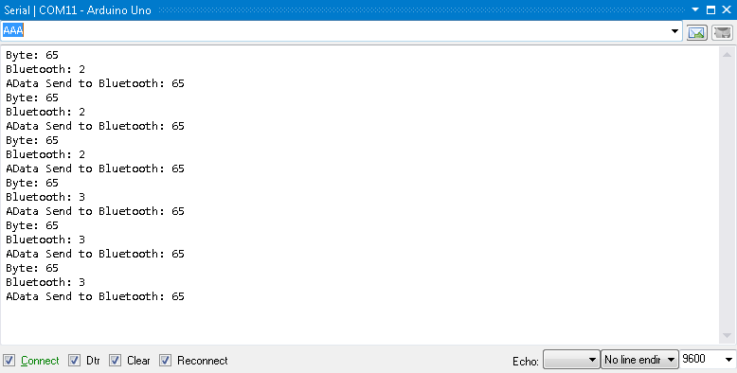

Slide 11
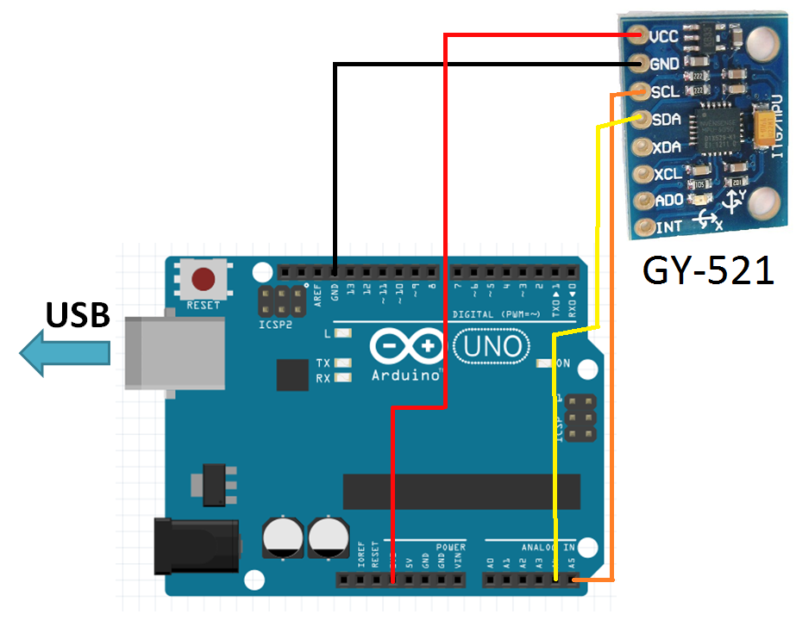
Orientation Sensor(MPU6050) Interface
I2C communication protocol

Slide 12
MPU6050 S/W Module
#include <Wire.h>
//Endereco I2C do MPU6050
const int MPU=0x68;
//Variaveis para armazenar valores dos sensores
int AcX,AcY,AcZ,Tmp,GyX,GyY,GyZ;
void setup()
{
Serial.begin(9600);
Wire.begin();
Wire.beginTransmission(MPU);
Wire.write(0x6B);
Wire.write(0);
Wire.endTransmission(true);
}
void loop()
{
Wire.beginTransmission(MPU);
Wire.write(0x3B); // starting with register 0x3B (ACCEL_XOUT_H)
Wire.endTransmission(false);
Wire.requestFrom(MPU,14,true);
AcX=Wire.read()<<8|Wire.read(); //0x3B (ACCEL_XOUT_H) & 0x3C (ACCEL_XOUT_L)
AcY=Wire.read()<<8|Wire.read(); //0x3D (ACCEL_YOUT_H) & 0x3E (ACCEL_YOUT_L)
AcZ=Wire.read()<<8|Wire.read(); //0x3F (ACCEL_ZOUT_H) & 0x40 (ACCEL_ZOUT_L)
Tmp=Wire.read()<<8|Wire.read(); //0x41 (TEMP_OUT_H) & 0x42 (TEMP_OUT_L)
GyX=Wire.read()<<8|Wire.read(); //0x43 (GYRO_XOUT_H) & 0x44 (GYRO_XOUT_L)
GyY=Wire.read()<<8|Wire.read(); //0x45 (GYRO_YOUT_H) & 0x46 (GYRO_YOUT_L)
GyZ=Wire.read()<<8|Wire.read(); //0x47 (GYRO_ZOUT_H) & 0x48 (GYRO_ZOUT_L)
Serial.print("AcX = "); Serial.print(AcX); Serial.print(" | AcY = "); Serial.print(AcY);
Serial.print(" | AcZ = "); Serial.print(AcZ); Serial.print(" | Tmp = "); Serial.print(Tmp/340.00+36.53);
Serial.print(" | GyX = "); Serial.print(GyX); Serial.print(" | GyY = ");
Serial.print(GyY); Serial.print(" | GyZ = "); Serial.println(GyZ);
delay(100);
}

Slide 13
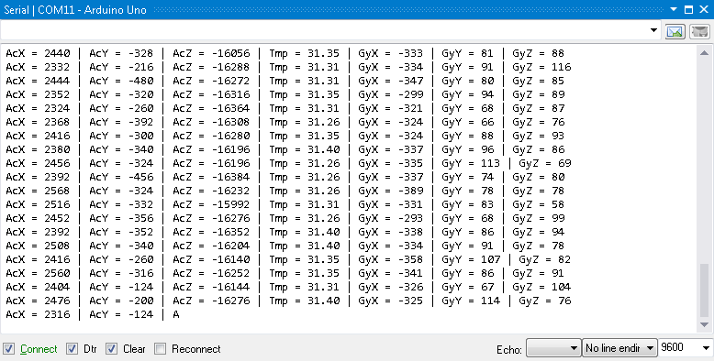
Result notes

Slide 14
Result notes
After sometime the output window crashes.
It might be Serial (Computer to Arduino) problem.
Need to test with Bluetooth module.

Slide 15
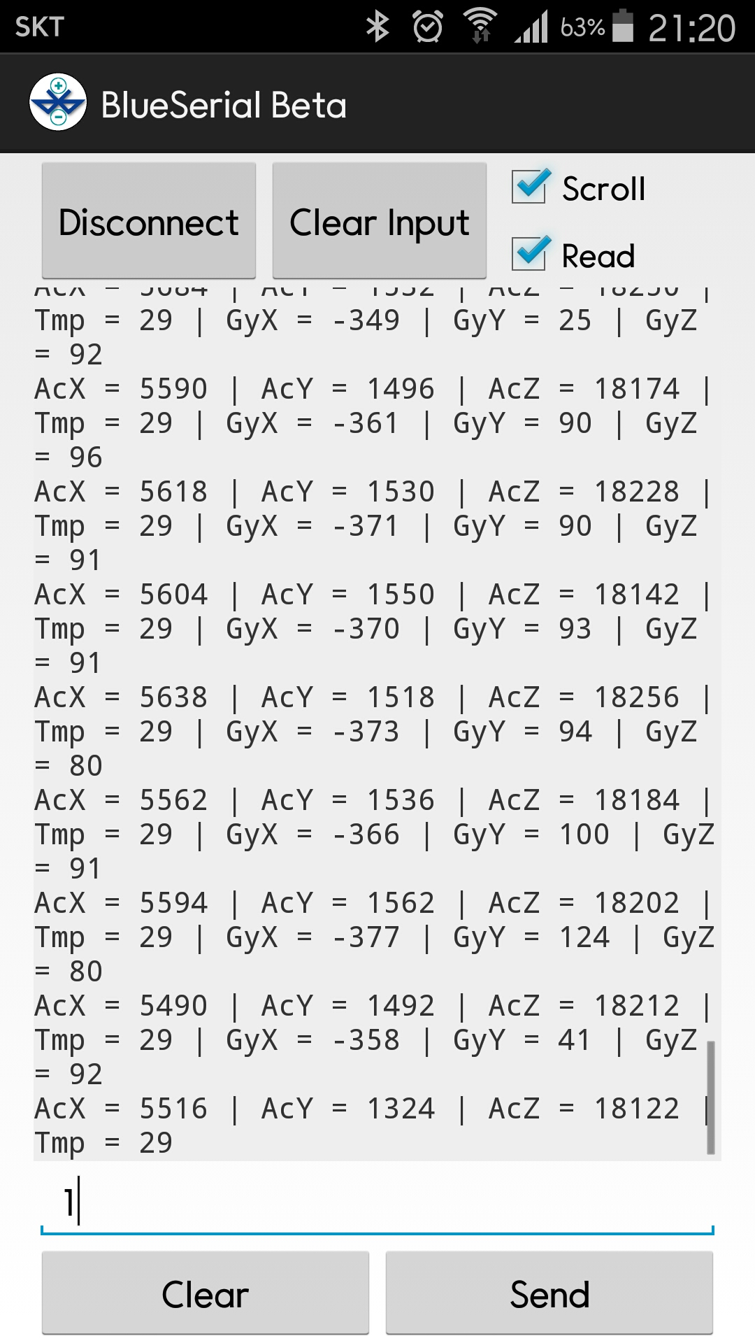
Send data to Android phone (MPU6050 data through Bluetooth)
Used BluSerial Beta android app.
Search Bluetooth device.
Select HC-06 and pair.
Send any char to start operation.

Slide 16
Source Code
#include <SoftwareSerial.h>
#include <Wire.h>
SoftwareSerial mySerial(2, 3); // RX, TX
//Endereco I2C do MPU6050
const int MPU=0x68;
//Variaveis para armazenar valores dos sensores
int AcX,AcY,AcZ,Tmp,GyX,GyY,GyZ;
void setup()
{
//Inicializa
Wire.begin();
Wire.beginTransmission(MPU);
Wire.write(0x6B);
//Inicializa o MPU-6050
Wire.write(0);
Wire.endTransmission(true);
Serial.begin(9600);
while(!Serial)
{
;// wait for serial port to connect. Needed for Leonardo only
}
// set the data rate for the SoftwareSerial port
mySerial.begin(9600);
mySerial.println("Hello, world?");
}

Slide 17
Source Code (cont…)
// Accelerometer X value
//Serial.print("Gyro:");
//Serial.print("AcX = "); Serial.print(AcX);
if(nBluetooth > 0)
{
itoa (AcX,buffer,10);
mySerial.write("AcX = "); mySerial.write(buffer);
}
// Accelerometer Y value
//Serial.print(" | AcY = "); Serial.print(AcY);
if(nBluetooth > 0)
{
itoa (AcY,buffer,10);
mySerial.write(" | AcY = "); mySerial.write(buffer);
}
// Accelerometer Z value
//Serial.print(" | AcZ = "); Serial.print(AcZ);
if(nBluetooth > 0)
{
itoa (AcZ,buffer,10);
mySerial.write(" | AcZ = "); mySerial.write(buffer);
}
// Temperature in Celsius
//Serial.print(" | Tmp = "); Serial.print(Tmp/340.00+36.53);
if(nBluetooth > 0)
{
itoa (Tmp/340.00+36.53,buffer,10);
mySerial.write(" | Tmp = "); mySerial.write(buffer);
}
// Gyroscope X value
Serial.print("GyX = "); Serial.print(GyX);
if(nBluetooth > 0)
{
itoa (GyX,buffer,10);
mySerial.write(" | GyX = "); mySerial.write(buffer);
}
// Gyroscope Y value
Serial.print(", GyY = "); Serial.print(GyY);
if(nBluetooth > 0)
{
itoa (GyY,buffer,10);
mySerial.write(" | GyY = "); mySerial.write(buffer);
}
// Gyroscope Z value
Serial.print(", GyZ = "); Serial.println(GyZ);
if(nBluetooth > 0)
{
itoa (GyZ,buffer,10);
mySerial.write(" | GyZ = "); mySerial.write(buffer); mySerial.write("\n");
}
delay(50);
}
void loop()
{
Wire.beginTransmission(MPU);
Wire.write(0x3B); // starting with register 0x3B (ACCEL_XOUT_H)
Wire.endTransmission(false);
// request to start
Wire.requestFrom(MPU,14,true);
//values from sensor
AcX=Wire.read()<<8|Wire.read(); //0x3B (ACCEL_XOUT_H) & 0x3C (ACCEL_XOUT_L)
AcY=Wire.read()<<8|Wire.read(); //0x3D (ACCEL_YOUT_H) & 0x3E (ACCEL_YOUT_L)
AcZ=Wire.read()<<8|Wire.read(); //0x3F (ACCEL_ZOUT_H) & 0x40 (ACCEL_ZOUT_L)
Tmp=Wire.read()<<8|Wire.read(); //0x41 (TEMP_OUT_H) & 0x42 (TEMP_OUT_L)
GyX=Wire.read()<<8|Wire.read(); //0x43 (GYRO_XOUT_H) & 0x44 (GYRO_XOUT_L)
GyY=Wire.read()<<8|Wire.read(); //0x45 (GYRO_YOUT_H) & 0x46 (GYRO_YOUT_L)
GyZ=Wire.read()<<8|Wire.read(); //0x47 (GYRO_ZOUT_H) & 0x48 (GYRO_ZOUT_L)
int nBluetooth = mySerial.available();
char buffer[32];

Slide 18
Source Code (cont…)
// Accelerometer X value
//Serial.print("Gyro:");
//Serial.print("AcX = "); Serial.print(AcX);
if(nBluetooth > 0)
{
itoa (AcX,buffer,10);
mySerial.write("AcX = "); mySerial.write(buffer);
}
// Accelerometer Y value
//Serial.print(" | AcY = "); Serial.print(AcY);
if(nBluetooth > 0)
{
itoa (AcY,buffer,10);
mySerial.write(" | AcY = "); mySerial.write(buffer);
}
// Accelerometer Z value
//Serial.print(" | AcZ = "); Serial.print(AcZ);
if(nBluetooth > 0)
{
itoa (AcZ,buffer,10);
mySerial.write(" | AcZ = "); mySerial.write(buffer);
}
// Temperature in Celsius
//Serial.print(" | Tmp = "); Serial.print(Tmp/340.00+36.53);
if(nBluetooth > 0)
{
itoa (Tmp/340.00+36.53,buffer,10);
mySerial.write(" | Tmp = "); mySerial.write(buffer);
}

Slide 19
Source Code (cont…)
// Gyroscope X value
Serial.print("GyX = "); Serial.print(GyX);
if(nBluetooth > 0)
{
itoa (GyX,buffer,10);
mySerial.write(" | GyX = "); mySerial.write(buffer);
}
// Gyroscope Y value
Serial.print(", GyY = "); Serial.print(GyY);
if(nBluetooth > 0)
{
itoa (GyY,buffer,10);
mySerial.write(" | GyY = "); mySerial.write(buffer);
}
// Gyroscope Z value
Serial.print(", GyZ = "); Serial.println(GyZ);
if(nBluetooth > 0)
{
itoa (GyZ,buffer,10);
mySerial.write(" | GyZ = "); mySerial.write(buffer);
mySerial.write("\n");
}
delay(50);
}

Slide 20
References
http://bildr.org/2012/11/flex-sensor-arduino/
http://blog.filipeflop.com/sensores/tutorial-acelerometro-mpu6050-arduino.html

Slide 21
Problem List
MPU6050:
The accelerometer and gyroscope measurements are explained in the MPU-6050 datasheet in the GYRO_CONFIG and ACCEL_CONFIG register descriptions (sections 4.4 and 4.5 on pages 14 and 15). The scale of each depends on the sensitivity settings chosen, which can be one of +/- 2, 4, 8, or 16g for the accelerometer and one of +/- 250, 500, 1000, or 2000 deg/sec for the gyroscope. The accelerometer produces data in units of acceleration (distance over time2), and the gyroscope produces data in units of rotational velocity (rotation distance over time).
The output scale for any setting is [-32768, +32767] for each of the six axes. The default setting in the I2Cdevlib class is +/- 2g for the accel and +/- 250 deg/sec for the gyro. If the device is perfectly level and not moving, then:
X/Y accel axes should read 0
Z accel axis should read 1g, which is +16384 at a sensitivity of 2g
X/Y/Z gyro axes should read 0
In reality, the accel axes won't read exactly 0 since it is difficult to be perfectly level and there is some noise/error, and the gyros will also not read exactly 0 for the same reason (noise/error).

Slide 22
MPU6050 Calibration
What I do to get calibration values using Arduino is the following:
- Put the MPU6050 in a flat and horizontal surface. Use an inclinometer to check that it is as horizontal as possible.
- Modify the RAW program to put every offset to 0. ("setXGyroOffset/setYGyroOffset/setZGyroOffset/setZAccelOffset" =0 ).
- Upload the RAW program to your arduino and open serial monitor so you can see the values it is returning.
- Leave it operating for a few minutes (5-10) so temperature gets stabilized.
- Check the values in the serial monitor and write them down.
- Now modify your program again updating your offsets and run the sketch, with updated offsets.
- Repeat this process until your program is returning 0 for every gyro, 0 for X and Y accel, and +16384 for Z accel.
Once you achieve this, those are the offsets for that MPU6050, you will have to repeat this for every MPU6050 you use.
*NOTES:
- If you stop the sketch for a while, sensor's temperature will get lower. If you only stop it to reprogram new offsets, you dont need to wait those 5-10 minutes every time.
- What you should try to achieve is to get the average of every gyro and XY accel to those values mentioned, so it is best if you modify the sketch to take, for example, 10000 measures, and just show on the serial monitor the average, because there is always some noise.
- It is not so straigthforward to update your offset every time. In my case, I had to put my initial readings, negated (change sign) and divided by 4 (gyros) and by 7.8 (accels).

Slide 23
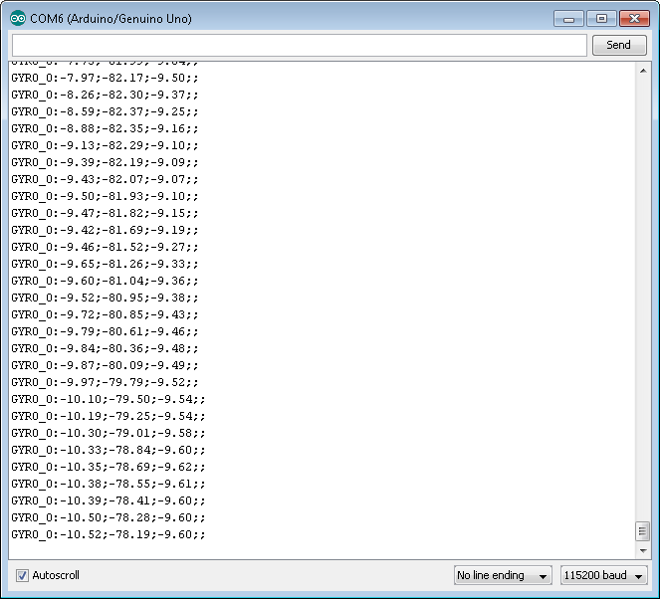
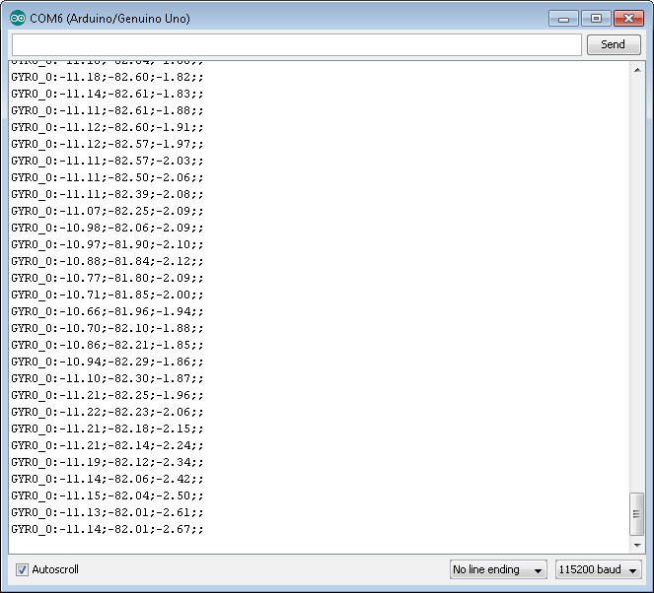
-10 -82 -2
-10 80 -9

Slide 24
